Slide 1
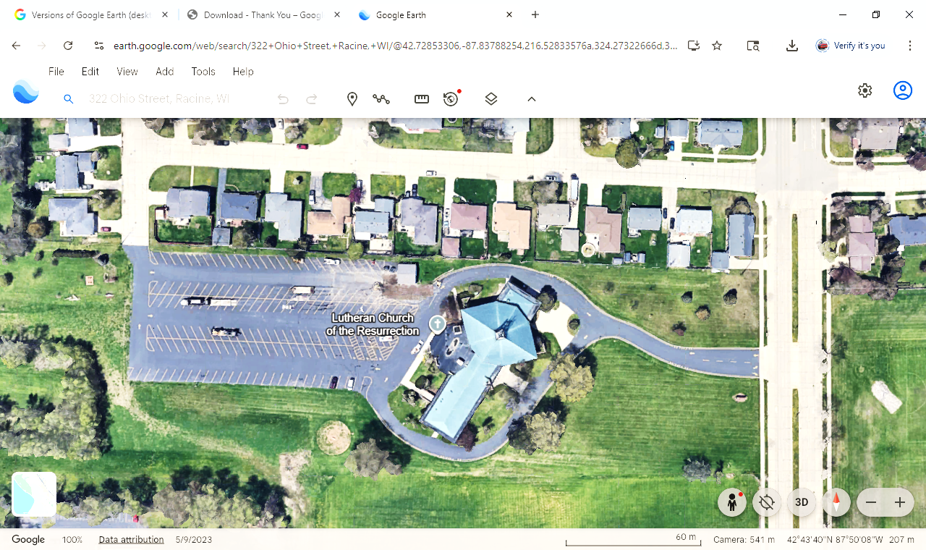

Slide 3
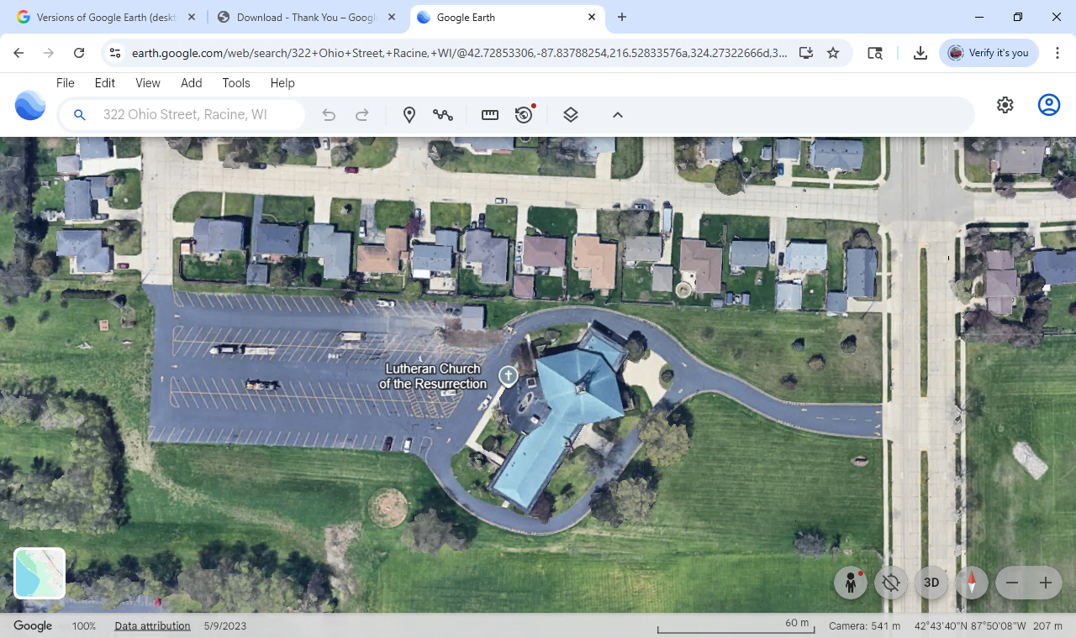
Westway Ave
Perry Ave
Ohio St
Follow
‘Show Cars’
Signs
&
Cones
NO ENTRY
XXX
Car Show
Parking
Tent

Slide 4
Westway Ave
Perry Ave
Ohio St
Follow
‘Show Cars’
Signs
&
Cones
NO ENTRY
XXX
Car Show
Parking
Tent
11x17

Slide 5
Westway Ave
Perry Ave
Car Show Entry
Ohio St
Craft Vendors Community Service
Main Parking
Area
Food Trucks
XXX
Bands
To Fest
Car Show
Parking
Tent
Kids Activities & Bouncies

Slide 6
Westway Ave
Perry Ave
Car Show Entry
Ohio St
Craft Vendors Community Service
Main Parking
Area
Food Trucks
XXX
Bands
To Fest
Car Show
Parking
Tent
Kids Activities & Bouncies
11x17

