Slide 1
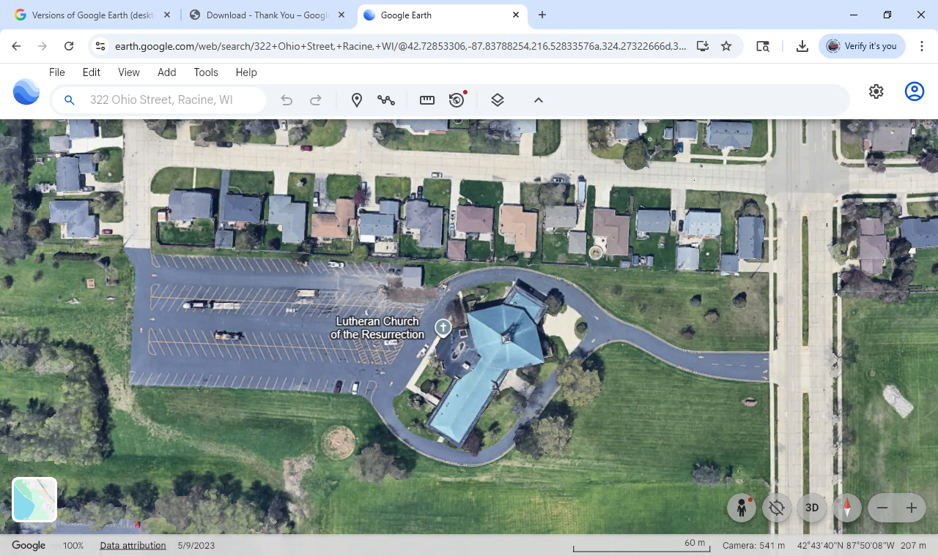
Westway Ave
Perry Ave
Car Show Entry
Ohio St
Craft Vendors Community Service
Main Parking
Area
Food Trucks
XXX
Bands
To Fest
Car Show
Parking
Tent
Kids Activities & Bouncies
11x17

Slide 2
Westway Ave
Perry Ave
Ohio St
Follow
‘Show Cars’
Signs
&
Cones
NO ENTRY
XXX
Car Show
Parking
Tent

Slide 3
Westway Ave
Perry Ave
A
D
Ohio St
B
D
F
C
B
Car Show
Parking
Tent
E
Cones
Caution Tape
Signage
A – Main Parking/ Show Car Parking
Pedestrian Crossing
B – Festival Entry →
E – Warning, on each bounce house
C – Rest Rooms →
F – Handicap RestRoom – On walls in Fellowship Hall
D – No Parking Loading Zone - Metal

Slide 4
