Slide 1

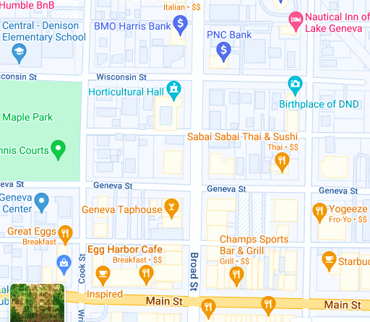

Horticultural Hall
330 Broad Street
Lake Geneva, WI 53147
Parking
– on-street
– BMO bank lot
(not in ATM line)
– School lot
– Town Bank lot, 2
blocks north on
Broad Street
Emily
&
Jake’s
Wedding

